Slide 1
Methods and application for pilots progress analysis on aircraft simulators
Performer: student Chykurov Maksym
Supervisor: associate professor Khomenko Volodymyr

Slide 2
Description and sence
A flight simulator is a device that artificially re-creates aircraft flight and the environment in which it flies, for pilot training, design, or other purposes.
Efficiency and skills of aircraft personnel is a key situation in safety of flights.
Staff has to pass many trainings and always maintain its skills regardless of experience. That is why it is necessary to perform regular training.
This makes pilot to stay on professional level and always be fit for any kinds of emergencies.
Moreover, simulating emergency situations force pilots to be fit and prepared for ones.

Slide 3
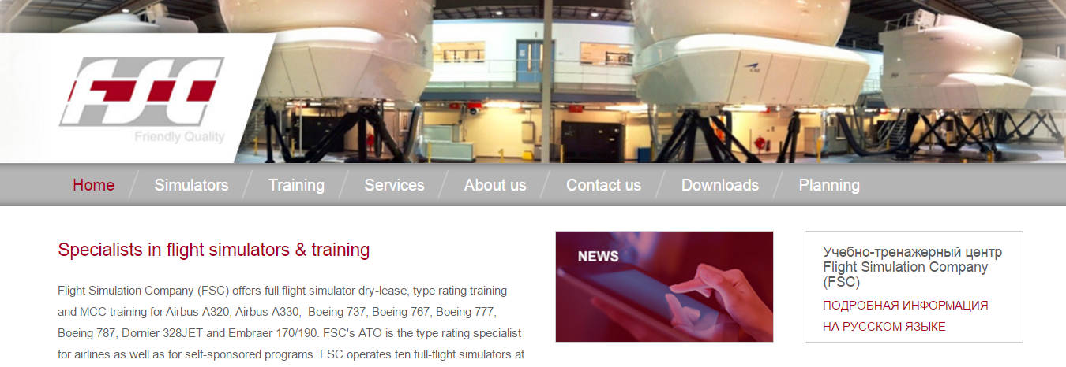
Working systems
Example of working portal for users represented by FCS training center.

Slide 4
Goal - Question - Metric
Conceptual level (Goal)
A goal is defined for an object, for a variety of reasons, with respect to various models of quality, from various points of view and relative to a particular environment.
Operational level (Question)
A set of questions is used to define models of the object of study and then focuses on that object to characterize the assessment or achievement of a specific goal.
Quantitative level (Metric)
A set of metrics, based on the models, is associated with every question in order to answer it in a measurable way.

Slide 5
Emergencies training approach
Goal | Question | Metric | Parameters
Assessment of correctness parry the failure of one engine. | Was screw of failed engine been vaned? | Indicator of vaning has become equal to 1 after the rejection. | fPR1, fPR2 (left, right)
Goal | Question | Metric | Parameters
 | Has failed engine been turned off? | Fuel valve closed | fPPA1, fPPA2
 |  | The stop valve has been closed | STK1, STK2
 | Was there a difference of traction trimmer aileron compensated? | The bank is less than 5 degrees in 30 seconds. | GAM

Slide 6
Emergencies training approach
Goal | Question | Metric | Parameters
Rate the quality of touch the runway | Was it a soft touch? | Vertical speed at the moment of contact. | VYP
 |  | The horizontal speed at the moment of contact. | VP
 | How right was the position of the aircraft at the moment of contact? | <Angle of list> | GAM
 |  | < Pitch> | TH

Slide 7
Overview of development process
Purpose .
Evaluation of pilots, maintaining pilot skills and provide information about flight simulation results.
Field of usage.
Flight simulators training centers with orientation on training semi-professional and professional pilots.
The objectives of application.
Make intuitive information resource that would help pilots perform their training and get evaluation, for instructors – to evaluate pilots.

Slide 8
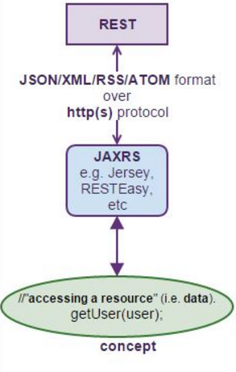
Overview of development process
INSTRUMENTS FOR DEVELOPMENT
MySQL
Java Enterprise Edition
Hibernate
JAX-RS
AngularJS
WildFly
JUnit

Slide 9
Design of system
Sub-system | Purpose
Flight simulator | Flight simulation is used to perform gathering data of pilot training process.
Main web-application | Web application stored locally and perform gathering data, calculation and user interface for comfort usage of application in web browser. Perform writing data and instructor evaluation to database.
User portal | Web site or portal for users to get to know the information about information center and evaluation of pilots.
Database | Storing the data for both main application and user portal.

Slide 10
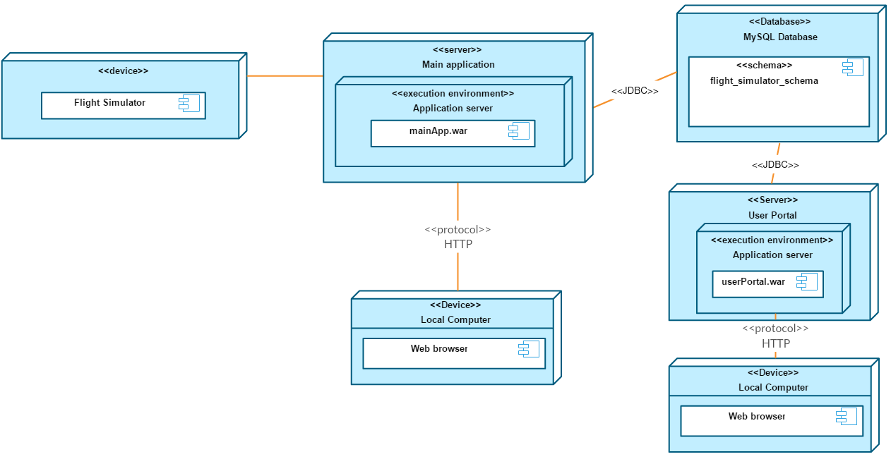
Deployment diagram

Slide 11
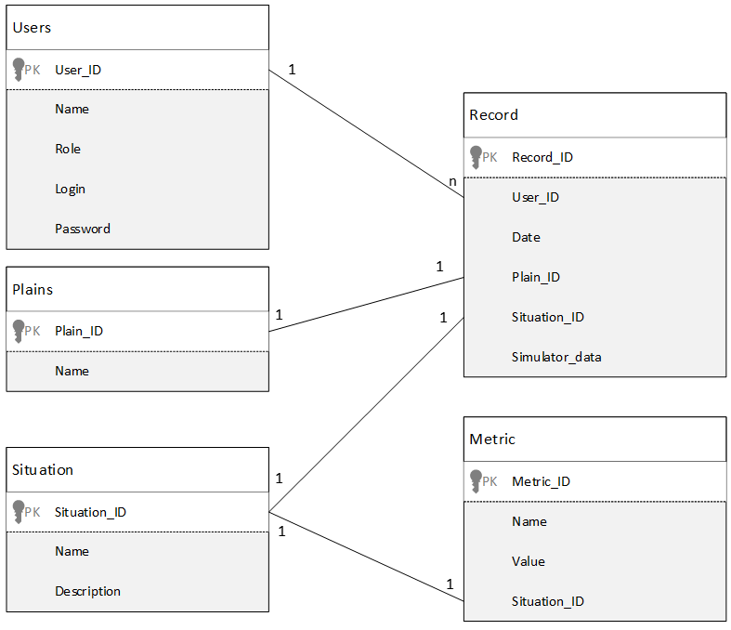
Database model

Slide 12
Design conclusion
For correct implementation of design patterns were decided dividing application layers into 4 packages:
Entities;
DAO interfaces;
DAO implementations;
RESTful classes

Slide 13
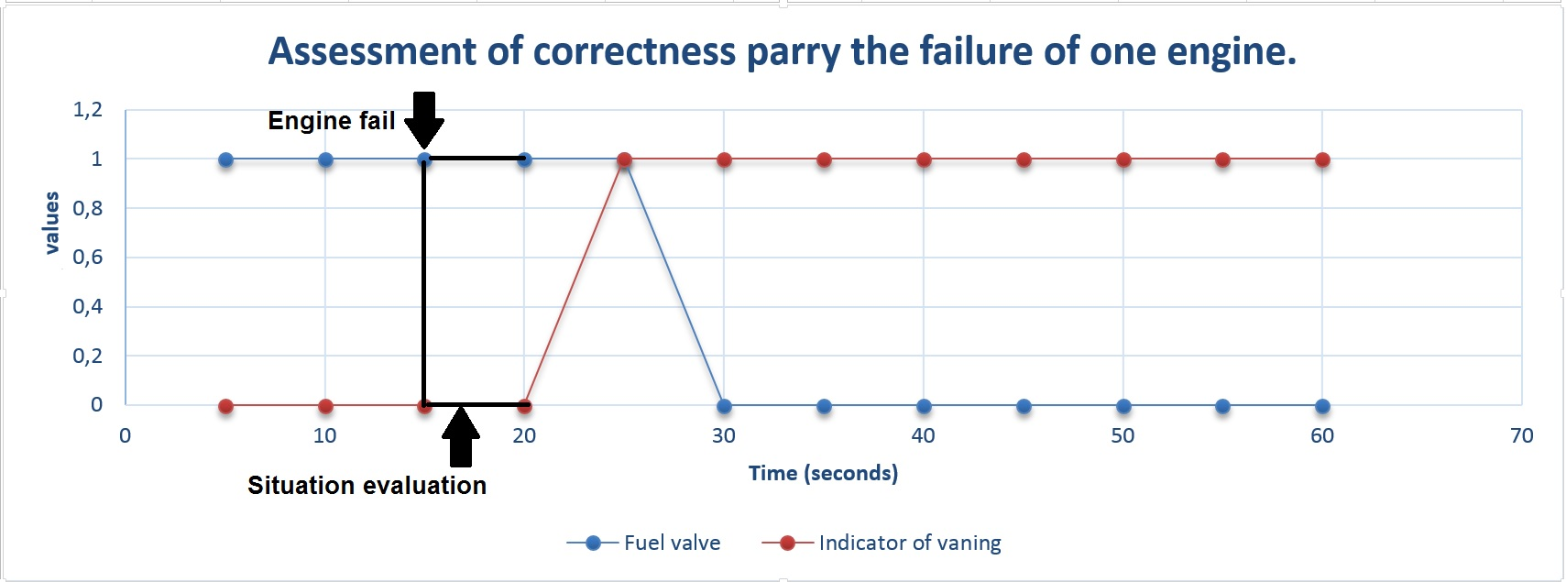
Diagram visualization of training process

Slide 14
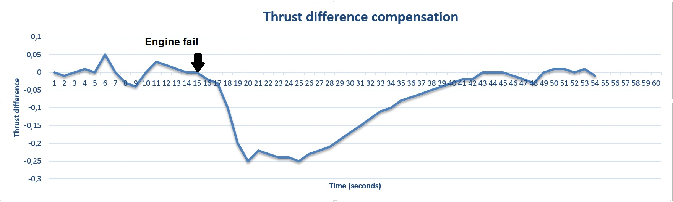
Diagram visualization of training process

Slide 15
Conclusion
As the result full system that covers all functional needs and provide all services that are needed was developed. System contains of following elements:
Flight simulator;
Main application;
User portal;
Database.

Slide 16
Thank you for attention

